Slide 1
Guide to Programming with Python
Chapter Eight
Software Objects: The Critter Caretaker Program

Slide 2
Objectives
Create classes to define objects
Write methods and create attributes for objects
Instantiate objects from classes
Restrict access to an object’s attributes
Work with both new-style and old-style classes
Guide to Programming with Python

Slide 3
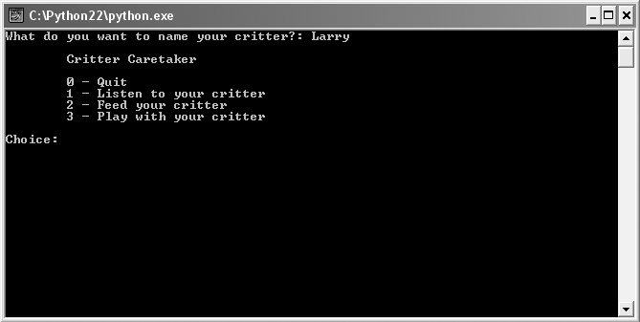
Chapter Project:
The Critter Caretaker Program
Figure 8.1: Sample run of the Critter Caretaker program
You get to name your very own critter.
Guide to Programming with Python

Slide 4
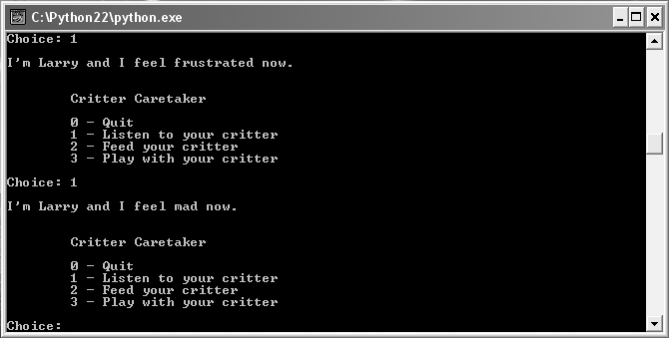
Chapter Project:
The Critter Caretaker Program (continued)
Figure 8.2: Sample run of the Critter Caretaker program
If you neglect your critter, it will have a mood change for the worse.
Guide to Programming with Python

Slide 5
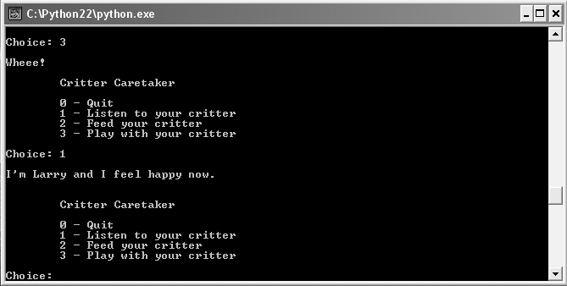
Chapter Project:
The Critter Caretaker Program (continued)
Figure 8.3: Sample run of the Critter Caretaker program
With the proper care, your critter will return to its sunny mood.
Guide to Programming with Python

Slide 6
Understanding Object-Oriented Basics
Object-oriented Programming (OOP): A methodology of programming where new types of objects are defined
Object: A single software unit that combines attributes and methods
Attribute: A "characteristic" of an object; like a variable associated with a kind of object
Guide to Programming with Python

Slide 7
Understanding Object-Oriented Basics (continued)
Method: A "behavior" of an object; like a function associated with a kind of object
Instance: A single object
Instantiate: To create an object
Class: Code that defines the attributes and methods of a kind of object
Guide to Programming with Python

Slide 8
Creating Classes, Methods, and Objects
OOP allows representation of real-life objects as software objects
Spacecraft objects
  Attribute: Energy level
  Method: Fire weapons
  Each object has similar structure (energy level and fire weapons) but each has unique values (one might have energy level of 3, another energy level of 10)
Guide to Programming with Python

Slide 9
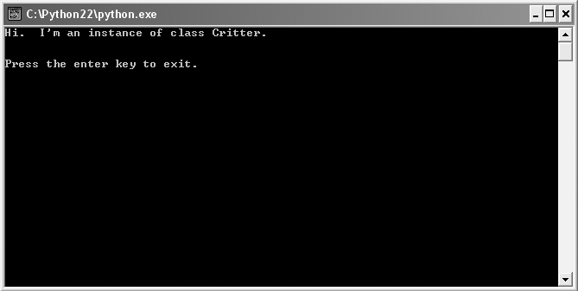
The Simple Critter Program
Figure 8.4: Sample run of the Simple Critter program
The Critter object’s talk() method makes the critter greet the world.
Guide to Programming with Python

Slide 10
The Simple Critter Program (continued)
class Critter(object):
"""A virtual pet"""
def talk(self):
print "Hi. I'm an instance of class Critter."
# main
crit = Critter()
crit.talk()
Guide to Programming with Python

Slide 11
Defining a Class
class Critter(object):
"""A virtual pet"""
class keyword
Class name, begin with capital letter
  Critter
Set of parentheses and class based on
  object, fundamental built-in type
Docstring, describes kind of objects
  """A virtual pet"""
Guide to Programming with Python

Slide 12
Defining a Method
def talk(self):
print "Hi. I'm an instance of class Critter."
Define a method like a function
Every instance method must have a special first parameter, called self by convention
Special first parameter provides way for a method to refer to object itself
Guide to Programming with Python

Slide 13
Instantiating an Object
crit = Critter()
Create new object with class name followed by set of parentheses
  Critter() creates new object of class Critter
Can assign a newly instantiated object to a variable of any name
  crit = Critter() assigns new Critter object to crit
Avoid using variable that's same name as the class name in lowercase letters
Guide to Programming with Python

Slide 14
Invoking a Method
crit.talk()
Any Critter object has method talk()
crit.talk() invokes talk() method of Critter object crit
Prints string "Hi. I'm an instance of class Critter."
Guide to Programming with Python

Slide 15
Using Constructors
Constructor: A special method that is automatically invoked right after a new object is created
Usually write one in each class
Usually sets up the initial attribute values of new object
Guide to Programming with Python

Slide 16
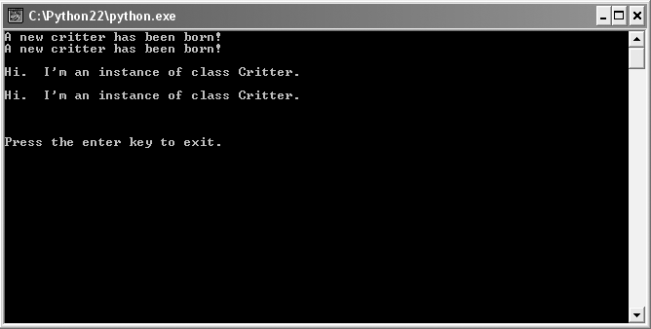
The Constructor Critter Program
Figure 8.5: Sample run of the Constructor Critter program
Two separate critters are created. Each says hi.
Guide to Programming with Python

Slide 17
Creating a Constructor
def __init__(self):
print "A new critter has been born!"
New Critter object automatically announces itself to world
__init__
  Is special method name
  Automatically called by new Critter object
Guide to Programming with Python

Slide 18
Creating Multiple Objects
crit1 = Critter()
crit2 = Critter()
Creating multiple objects is easy
Two objects created here
Each object is independent, full-fledged critter
Guide to Programming with Python

Slide 19
Using Attributes
Can have object’s attributes automatically created and initialized through constructor
Big convenience; done often
Guide to Programming with Python

Slide 20
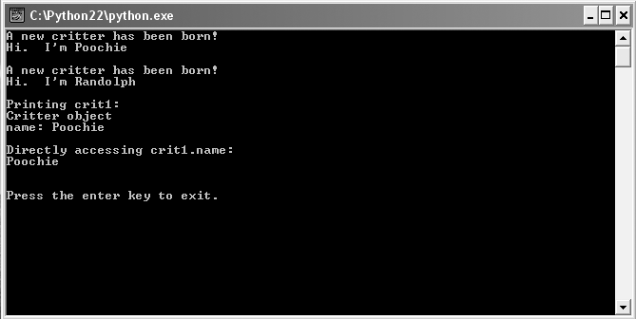
The Attribute Critter Program
Figure 8.6: Sample run of the Attribute Critter program
Each Critter object has attribute name it uses when it says hi.
Guide to Programming with Python

Slide 21
Initializing Attributes
class Critter(object):
def __init__(self, name):
self.name = name
self
  First parameter in every instance method
  Automatically receives reference to the object invoking method
  Allows method to get at the object itself to access object’s attributes or methods (or even create new attributes)
Guide to Programming with Python

Slide 22
Initializing Attributes (continued)
class Critter(object):
def __init__(self, name):
self.name = name
...
crit1 = Critter("Poochie")
self receives reference to new Critter object
name receives "Poochie"
self.name = name creates the attribute name for object and sets to "Poochie"
crit1 gets new Critter object
Guide to Programming with Python

Slide 23
Accessing Attributes
class Critter(object):
...
def talk(self):
print "Hi. I'm", self.name, "\n"
...
crit1.talk()
talk() method
  Uses a Critter object’s name attribute
  Receives reference to the object itself into self
  Prints Hi. I'm Poochie by accessing attribute name of particular object through self.name
Guide to Programming with Python

Slide 24
Accessing Attributes (continued)
class Critter(object):
def __init__(self, name):
self.name = name
...
crit1 = Critter("Poochie")
print crit1.name
print crit1.name prints string "Poochie"
Can access object attribute outside class with dot notation – but should avoid
Guide to Programming with Python

Slide 25
Printing an Object
class Critter(object):
...
def __str__(self):
rep = "Critter object\n"
rep += "name: " + self.name + "\n"
return rep
...
print crit1
__str__
  Another special method
  Returns string representation of object
Guide to Programming with Python

Slide 26
Using Class Attributes and Static Methods
Class attribute: A single attribute that’s associated with a class itself
Static method: A method that’s associated with a class itself
Class attribute could be used for number of objects instantiated, for example
Static methods often work with class attributes
Guide to Programming with Python

Slide 27
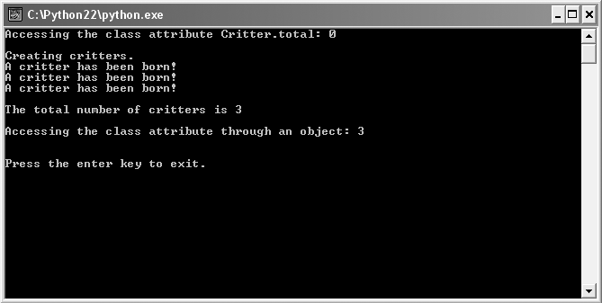
The Classy Critter Program
Figure 8.7: Sample run of the Classy Critter program
Total number objects with class attribute, displayed by static method
Guide to Programming with Python

Slide 28
Creating a Class Attribute
class Critter(object):
total = 0
total = 0 creates class attribute total set to 0
Assignment statement in class but outside method creates class attribute
Assignment statement executed only once, when Python first sees class definition
Class attribute exists even before single object created
Can use class attribute without any objects of class in existence
Guide to Programming with Python

Slide 29
Accessing a Class Attribute
class Critter(object):
total = 0
def status():
print "Total critters", Critter.total
status = staticmethod(status)
def __init__(self, name):
Critter.total += 1
print Critter.total
...
print crit1.total
Guide to Programming with Python

Slide 30
Accessing a Class Attribute (continued)
Access class attribute with dot notation - both inside class or out
  Critter.total += 1 #inside class
  print Critter.total #outside class
Can access class attribute through class instance
  print crit1.total
But can't assign new value through instance
  crit1.total += 1 # won’t work as might expect
Guide to Programming with Python

Slide 31
Creating a Static Method
class Critter(object):
...
def status():
print "Total critters", Critter.total
status = staticmethod(status)
status()
  Is static method
  Doesn't have self in parameter list because method will be invoked through class not object
Guide to Programming with Python

Slide 32
Creating a Static Method (continued)
staticmethod()
  Built-in Python function
  Takes method and returns static method
status = staticmethod(status)
  Takes method status() and returns static method
  Assigns static method to status and that name used to call static method
Guide to Programming with Python

Slide 33
Invoking a Static Method
...
crit1 = Critter("critter 1")
crit2 = Critter("critter 2")
crit3 = Critter("critter 3")
Critter.status()
Critter.status()
  Invokes static method status() defined in Critter
  Prints a message stating that 3 critters exist
  Works because constructor increments class attribute total, which status() displays
Guide to Programming with Python

Slide 34
Understanding Object Encapsulation
Client code should
  Communicate with objects through method parameters and return values
  Avoid directly altering value of an object’s attribute
Objects should
  Update their own attributes
  Keep themselves safe by providing indirect access to attributes through methods
Guide to Programming with Python

Slide 35
Using Private Attributes and Private Methods
Public: Can be directly accessed by client code
Private: Cannot be directly accessed (easily) by client code
Public attribute or method can be accessed by client code
Private attribute or method cannot be (easily) accessed by client code
By default, all attributes and methods are public
But, can define an attribute or method as private
Guide to Programming with Python

Slide 36
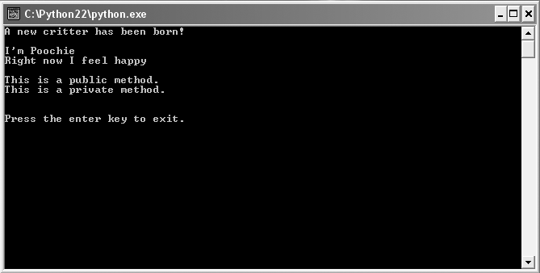
The Private Critter Program
Figure 8.8: Sample run of the Private Critter program
Object’s Private attribute and private method are indirectly accessed.
Guide to Programming with Python

Slide 37
Creating Private Attributes
class Critter(object):
def __init__(self, name, mood):
self.name = name # public attribute
self.__mood = mood # private attribute
name
  Created as any attribute before
  Public attribute (default)
__mood
  Private attribute
  Two underscore characters make private attribute
  Begin any attribute with two underscores to make private
Guide to Programming with Python

Slide 38
Accessing Private Attributes
class Critter(object):
...
def talk(self):
print "\nI'm", self.name
print "Right now I feel", self.__mood, "\n"
Private attributes
  Can be accessed inside the class
  Can’t be accessed directly through object
    crit1.__mood won’t work
  Technically possible to access through object, but shouldn’t
Guide to Programming with Python

Slide 39
Creating Private Methods
class Critter(object):
...
def __private_method(self):
print "This is a private method."
Like private attributes, private methods defined by two leading underscores in name
__private_method() is a private method
Guide to Programming with Python

Slide 40
Accessing Private Methods
class Critter(object):
...
def public_method(self):
print "This is a public method."
self.__private_method()
Like private attributes, private methods
  Can be accessed inside class
  Can’t be accessed directly through object
    crit1.__private_method() won’t work
  Technically possible to access through object, but shouldn’t
Guide to Programming with Python

Slide 41
Respecting an Object’s Privacy
crit = Critter(name = "Poochie", mood = "happy")
crit.talk()
crit.public_method()
Code accesses only public methods
Public methods access private methods and attributes
Guide to Programming with Python

Slide 42
Understanding When to Implement Privacy
Classes
  Write methods so no need to directly access object’s attributes
  Use privacy only for attributes and methods that are completely internal to operation of object
Objects
  Minimize direct reading of object’s attributes
  Avoid directly altering object’s attributes
  Never directly access object’s private attributes or methods
Guide to Programming with Python

Slide 43
Understanding New-Style and Old-Style Classes
class Critter(object): # new-style class
class Critter: # old-style class
New-style class: A class that is directly or indirectly based on the built-in object
Old-style class: A class that is not based on object, directly or indirectly
New-style classes
  Introduced in Python 2.2
  Significant improvements over old-style
  Create instead of old-style classes whenever possible
Guide to Programming with Python

Slide 44
Controlling Attribute Access
Instead of denying access to an attribute, can limit access to it
Example: client code can read, but not change attribute
Properties can manage how attribute is accessed or changed
Guide to Programming with Python

Slide 45
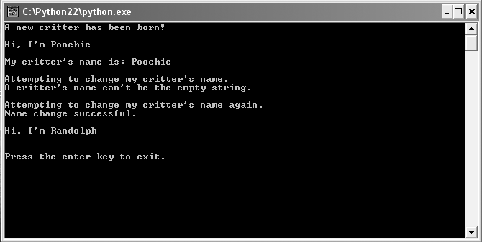
The Property Critter
Figure 8.9: Sample run of the Property Critter program
Property controls access to Critter object’s attribute for its name.
Guide to Programming with Python

Slide 46
Using Get Methods
class Critter(object):
...
def get_name(self):
return self.__name
Get method: A method that gets the value of an attribute, which is often private; by convention, name starts with “get”
get_name() provides indirect access to __name
Guide to Programming with Python

Slide 47
Using Get Methods (continued)
>>> crit = Critter("Poochie")
>>> print crit.get_name()
Poochie
get_name() returns string for Critter object’s name
Guide to Programming with Python

Slide 48
Using Set Methods
class Critter(object):
...
def set_name(self, new_name):
if new_name == "":
print "Critter's name can't be empty string."
else:
self.__name = new_name
print "Name change successful."
name = property(get_name, set_name)
Guide to Programming with Python

Slide 49
Using Set Methods (continued)
>>> crit.set_name("")
Critter’s name can’t be empty string.
>>> crit.set_name("Randolph")
Name change successful.
>>> print crit.get_name()
Randolph
Set method: Sets an attribute, usually private, to a value; by convention, name starts with "set"
set_name() allows a value to be assigned to private variable __name; imposes restriction that the value cannot be the empty string
Guide to Programming with Python

Slide 50
Using Properties
class Critter(object):
...
name = property(get_name, set_name)
Property: An interface that allows indirect access to an attribute by wrapping access methods around dot notation
property() function
  Takes accessor methods and returns a property
  Supply with get and set methods for controlled access to private attribute
  Supply only get method for “read-only” property
Guide to Programming with Python

Slide 51
Using Properties (continued)
>>> print crit.name
Randolph
>>> crit.name = "Sammy"
Name change successful.
>>> print crit.name
Sammy
>>> crit.name = ""
Critter's name can't be empty string.
Guide to Programming with Python

Slide 52
Summary
Object-oriented Programming (OOP) is a methodology of programming where new types of objects are defined
An object is a single software unit that combines attributes and methods
An attribute is a “characteristic” of an object; like a variable associated with an object
A method is a “behavior” of an object; like a function associated with an object
A class defines the attributes and methods of a kind of object
Guide to Programming with Python

Slide 53
Summary (continued)
Each instance method must have a special first parameter, called self by convention, which provides a way for a method to refer to object itself
A constructor is a special method that is automatically invoked right after a new object is created
A class attribute is a single attribute that’s associated with a class itself
A static method is a method that’s associated with a class itself
Guide to Programming with Python

Slide 54
Summary (continued)
Public attributes and methods can be directly accessed by client code
Private attributes and methods cannot (easily) be directly accessed by client code
A get method gets the value of an attribute; by convention, its name starts with “get”
A set method sets an attribute to a value; by convention, its name starts with “set”
A property wraps access (get and set) methods around dot notation syntax
Guide to Programming with Python

